Slide 1
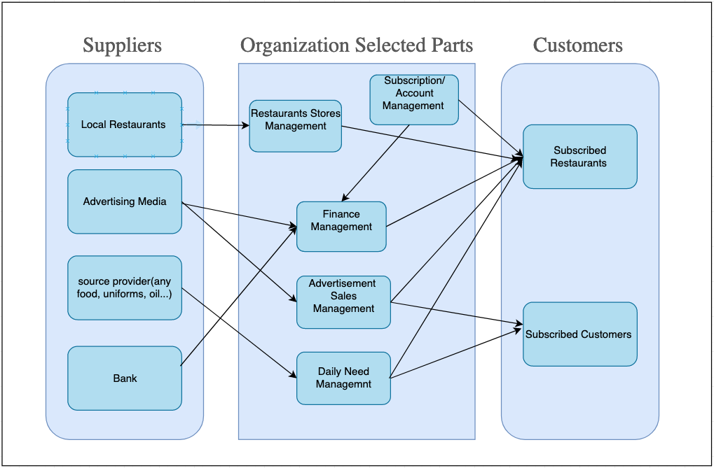
Super Servoli Systems Business Relationship Map

Slide 2
User Roles by Business Group
Business Group | User Roles | Team Member Name
Restaurants Stores Management | Partner Relationship Manager(responsible for local restaurant partners)
Advertisement Sales Management | Advertisement Sales Representative Food popularity trend Analyst Recipe Specialist
Subscription/ Account Management | Account Manager
Finance Management | Accountant
Daily Need Management | Daily Need Manager Recipe Specialist

